Slide 1
Digital Portfolio
Student Name : Kavya S
Register No : 36324u18021
Department : BSc (Computer Science)
College : Sree Abiraami Arts And Science College For Women
University :Thiruvalluvar University
EMAIL ID :KAVYASANKAR182007@GMAIL.COM

Slide 2
PROJECT TITLE
DIGITAL PORTFOLIO

Slide 3


AGENDA
Problem Statement
Project Overview
End Users
Tools and Technologies
Portfolio design and Layout
Features and Functionality
Results and Screenshots
8.Github link
9.Conclucsion
3/21/2024 Annual Review

Slide 4

PROBLEM STATEMENT
Many individuals struggle to showcase their skills and achievements effectively. Traditional resumes lack creativity and depth. This portfolio aims to solve that by providing a visually engaging, personalized platform to highlight talents, experiences, and projects—empowering users to make a lasting impression in competitive professional environments.

Slide 5

PROJECT OVERVIEW
This project showcases innovative design and strategic execution across digital platforms. It highlights creative problem-solving, user-centric development, and impactful visual storytelling. From concept to completion, each element reflects a commitment to excellence, adaptability, and growth—demonstrating both technical proficiency and a passion for delivering meaningful user experiences.

Slide 6

WHO ARE THE END USERS?
End users of the portfolio include investors, financial analysts, fund managers, and stakeholders seeking performance insights and strategic allocation. It also serves business executives, compliance teams, and advisors who rely on data-driven decisions. The portfolio empowers informed planning, risk assessment, and growth tracking across diverse financial and operational domains.

Slide 7

TOOLS AND TECHNIQUES
Effective portfolio development involves diverse tools and techniques such as SWOT analysis, risk assessment, asset allocation, diversification, and performance tracking. Utilizing financial software, market research, and strategic rebalancing ensures optimal returns. These methods help align investment goals with market trends, enhancing decision-making and long-term portfolio growth.

Slide 8
POTFOLIO DESIGN AND LAYOUT
A well-crafted portfolio blends creativity with clarity. Use clean layouts, consistent typography, and a cohesive color palette to reflect your personal brand. Highlight key projects with visuals and concise descriptions. Prioritize user-friendly navigation and responsive design. Let your portfolio tell your story—professionally, aesthetically, and with purpose.
8

Slide 9
FEATURES AND FUNCTIONALITY
Showcase your skills with a dynamic portfolio featuring sleek design, responsive layout, and interactive elements. Highlight projects, achievements, and testimonials with customizable sections. Integrate contact forms, social links, and downloadable resumes. Optimized for all devices, it ensures seamless navigation and a professional impression that reflects your unique creative identity.

Slide 10
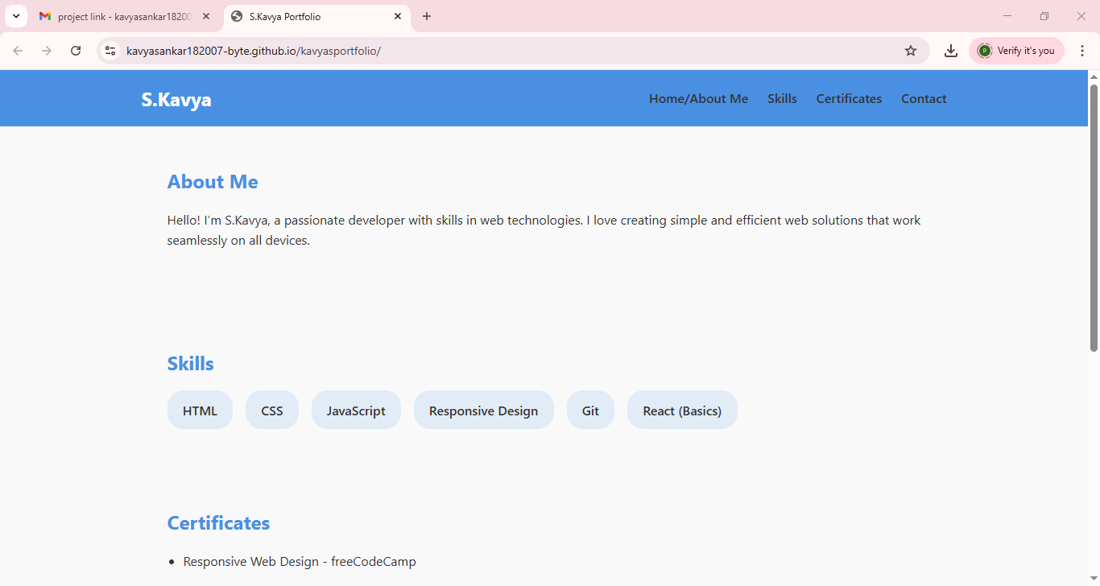

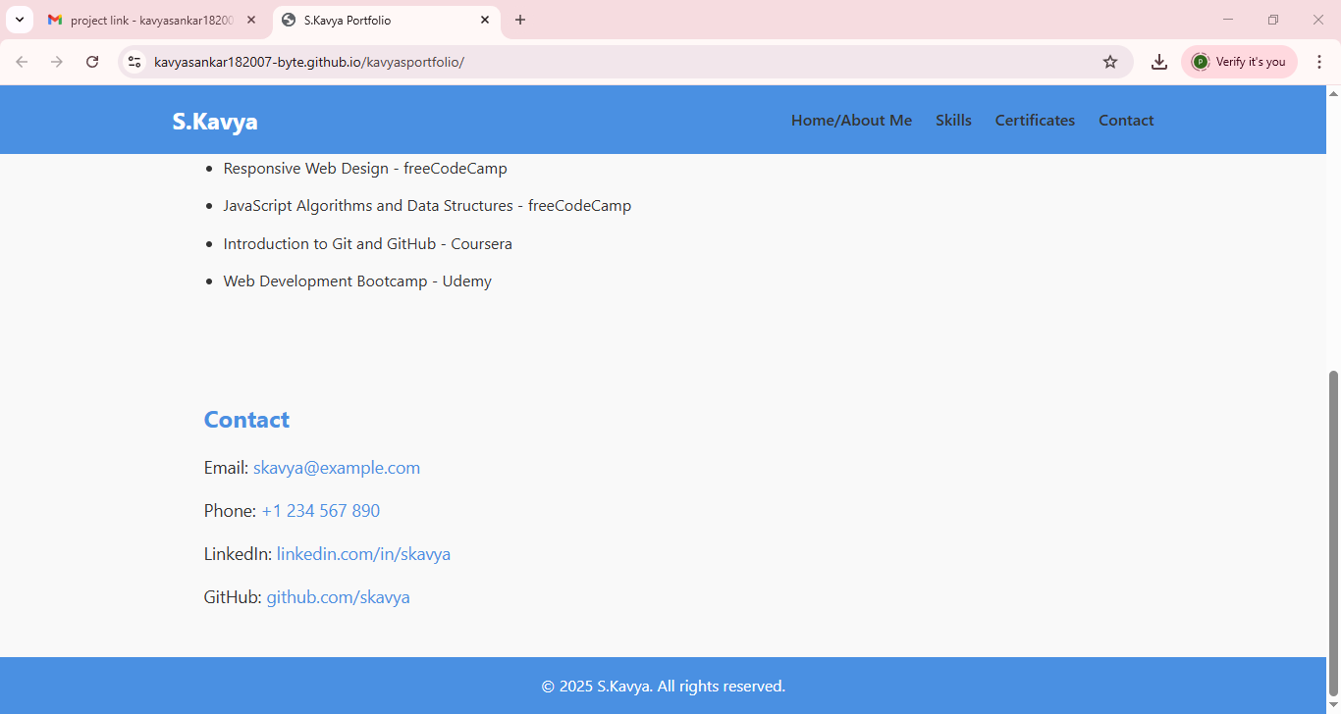
RESULTS AND SCREENSHOTS
3/21/2024 Annual Review
10

Slide 11
GITHUB LINK
https://kavyasankar182007-byte.github.io/kavyasportfolio/
11

Slide 12
CONCLUSION
This portfolio reflects my creative journey, growth, and dedication to excellence. Each piece showcases my skills, passion, and evolving perspective. As I continue to learn and explore, I remain committed to pushing boundaries and delivering impactful work. Thank you for viewing—this is just the beginning of what I aim to achieve.
12

